Slide 1
Designing Great Learning Sessions
Notes:
Welcome
Tech Notes for the Day
How We Will Participate – physical thumbs up, off mute as much as possible, tell me if tech isn’t working

Slide 2
Hello!
I am Kristina.

Slide 3
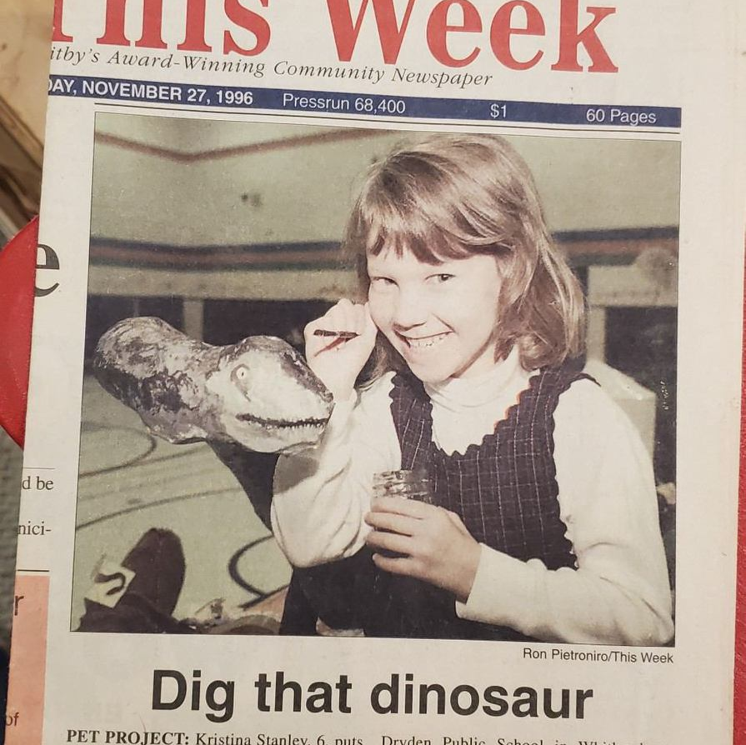
Favourite Classroom Moment
Notes:
Reflect on a favourite classroom moment.
What was it and what makes this experience stand out?

Slide 4
Learning Objectives
Identify the needs of adult learners to design successful learning experiences
Build our knowledge of instructional design theories
Establish best practices for a learning experience

Slide 5
Agenda
Adult Learner Needs (15 min)
Frameworks for Designing a Learning Session (30 min)
Kolb’s Theory of Learning
Bloom’ s Taxonomy
Design Thinking
Creating a Session Structure (20 min)
Wrap Up and Next Steps ( 15 min)

Slide 6
What do Adult Learners need?
Head to https://www.menti.com/aljt2prbmcmg
Notes:
Facilitator link: https://www.mentimeter.com/app/presentation/al8cqamvqqmbb8d2wng2nbgndfxxfgg2/jsacmdx396n2

Slide 7
Clear sense of purpose - why am I here? What am I going to learn?
Clear bounds of time - I am a busy adult!
A safe environment - inclusive and leverages adult’s life experience
Experience caters to different styles of learning

Slide 8
Kolb’s Theory of Learning

Slide 9
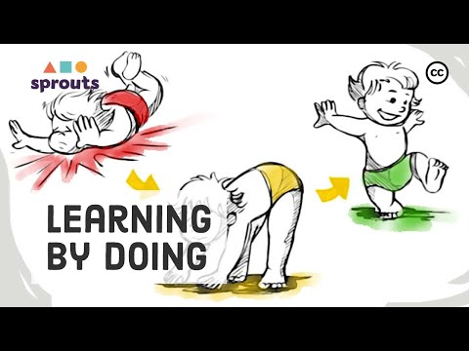
Notes:
https://www.youtube.com/watch?v=aF63HHVbpQ8

Slide 10
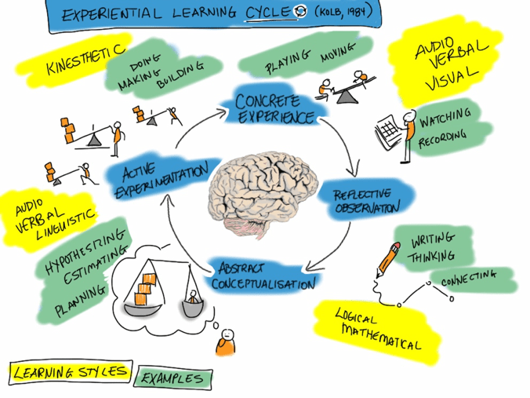

Slide 11
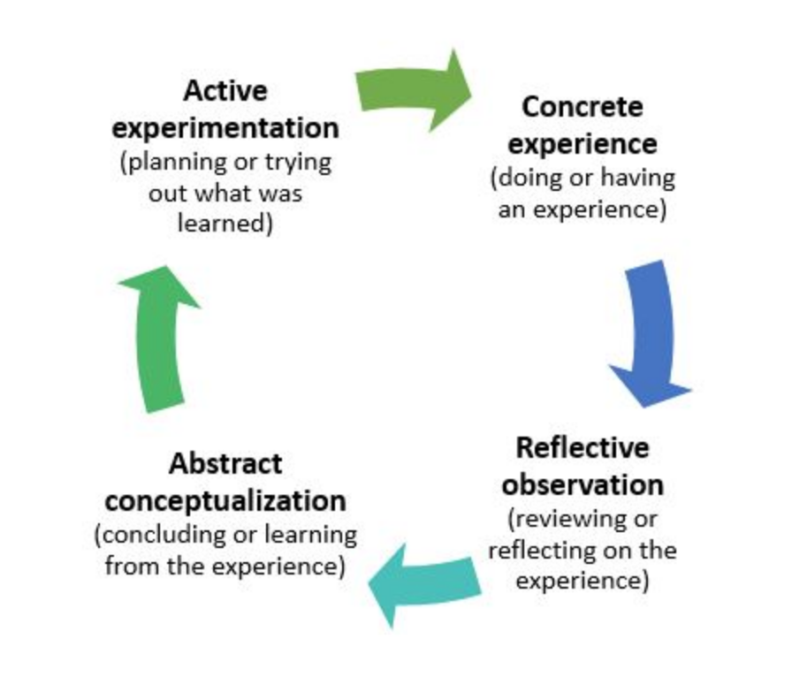
The 4 Stages
Notes:
Reflect back on your classroom moment, does it follow the four stages? What stage do you remember the most?

Slide 12
What learning stage do we value?
Head to https://www.menti.com/aljt2prbmcmg
Notes:
Facilitator link: https://www.mentimeter.com/app/presentation/al8cqamvqqmbb8d2wng2nbgndfxxfgg2/jsacmdx396n2

Slide 13
How do I apply this theory?
When designing your session, create activities that cross the different stages
Reflection/Observation is the easy place to start and end, but doesn’t have to be
Not every stage all has to be done in your session, but crossing all 4 stages is key to learning a complex concept

Slide 14
Bloom’s Taxonomy

Slide 15
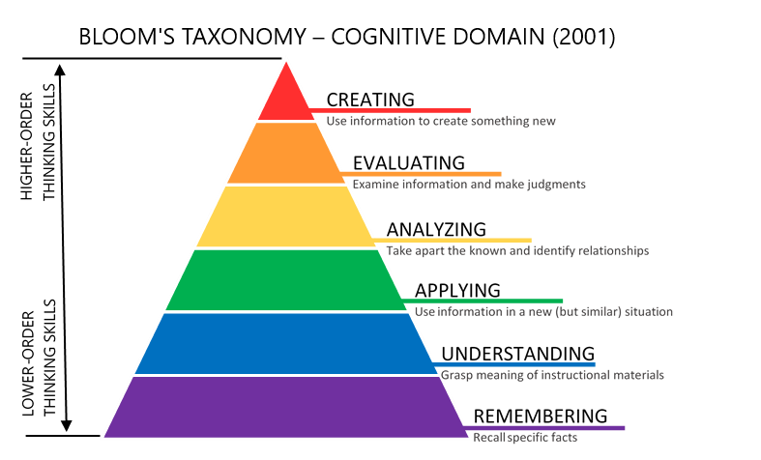
Notes:
Created by Benjamin Bloom and updated in 2011
Organizes what we are learning by the level of complexity
Assume hierachy

Slide 16
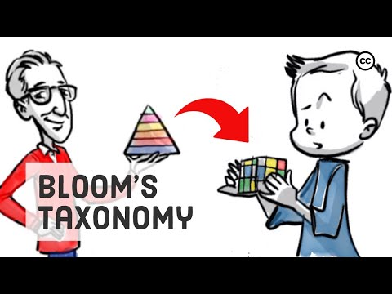
Notes:
https://www.youtube.com/watch?v=ayefSTAnCR8&vl=en

Slide 17
How do I apply this theory?
Consider the depth – how complex are learners diving into the topic in your learning experience?
Consider what level learners may already be at
Does not have to be applied linearly
Extremely helpful for creating learning objectives

Slide 18

Notes:
https://www.youtube.com/watch?v=8YV8KmfBbBM
Start at 23:20 minutes

Slide 19
What levels of learning were covered in the video?
Notes:
Option to use Zoom annotate to indicate

Slide 20
Design Thinking/ Human Centered Design

Slide 21
What is Design Thinking?
A concept developed and popularized by the Standford D.School and Ideo
Design thinking is a process, mindset, and approach to solving complex problems
It is hands-on and focuses on the users in order to create new ideas.
It works through a clearly defined problem statement
Its flexible and interactive – be ready to change the problem or modify your prototype
Notes:
https://www.ideou.com/blogs/inspiration/what-is-design-thinking
https://www.nngroup.com/articles/design-thinking/
https://medium.com/dc-design/what-is-human-centered-design-6711c09e2779

Slide 22
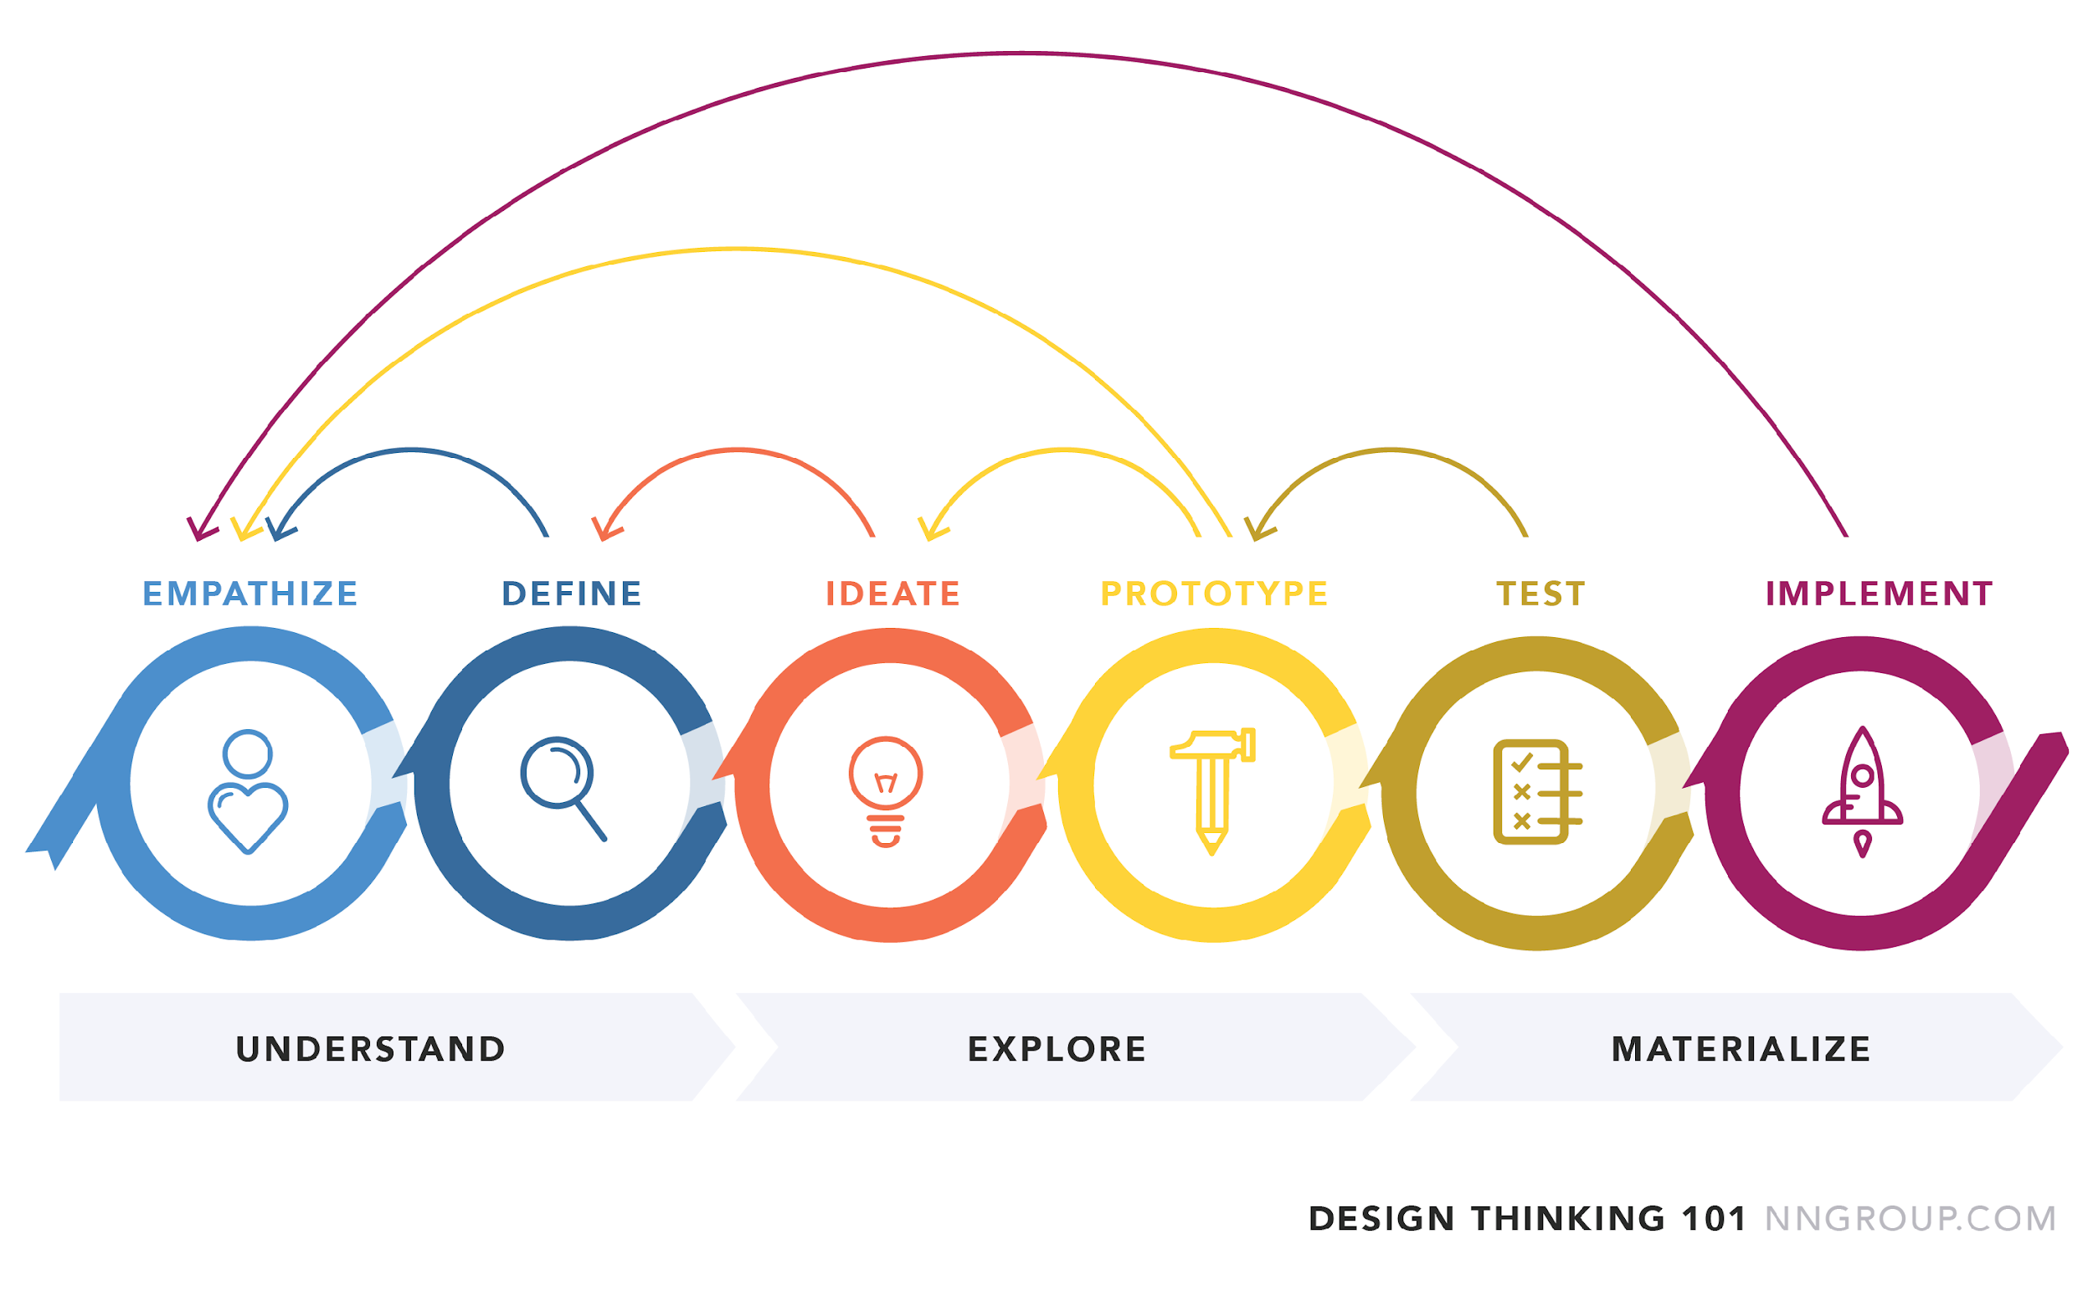
Notes:
Empathize – we conduct research and understand our users. We ask for real world experiences
Define – we combine our research to understand user needs and challenge areas
Ideate – we create crazy ideas through a creative process
Prototype – we take our ideas and turn them into something tactile to use and experiment
Test – we get us er feedback
Implement – put the vision into effect

Slide 23
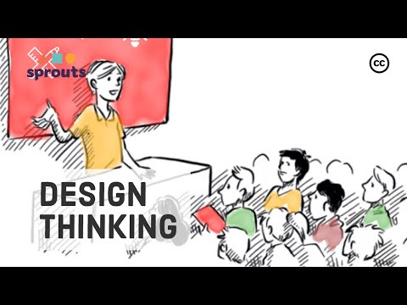
Notes:
https://www.youtube.com/watch?v=_r0VX-aU_T8

Slide 24
How do I apply this theory?
A lot of overlap with experiential learning cycle in terms of flow for user
Problem solving framework - great framework if that is the aim of your session
Process for idea creation - great framework if that is the aim of your session
Become an expert https://acumenacademy.org/course/design-kit-human-centered-design/

Slide 25
In my online workshops, I have noticed my learners seem disengaged. They have blank screens, don’t respond and aren’t remembering the information when it comes to test time.
What should I do?
Head to https://jamboard.google.com/d/1D5tjQUv7vYQ2hGO2Ka8IcNTivCLkTUMf6fdaQyhU9S8/viewer?f=0
Notes:
https://jamboard.google.com/d/1D5tjQUv7vYQ2hGO2Ka8IcNTivCLkTUMf6fdaQyhU9S8/viewer?f=0

Slide 26
Creating a Learning Session Structure

Slide 27
Start with Learning Objectives
THIS IS A MUST
A Learning Objective Must haves:
a verb,
a description of the conditions and
a measurement
For example:
How to Lose a Guy in 10 Days
Operate social media software to post one campaign successfully.
Looking for verbs? Try these
Notes:
A must have - it doesn’t always have to be formal
When - Course overview, start of your mini session, recap at the end
They also inform how you know you were successful as an instructor, you need to make this before you evaluate if people learnt anything

Slide 28
Provide your Learners Direction
Have an Agenda, can be shared in advance
Set participation and engagement rules up front
Consider the provided frameworks and stages for flow
Use activities to push learners through the learning stages

Slide 29
Resources and Documentation
Graphic Design Matters – consider your slide look and feel, keep text minimal
Offloading is key – what needs to be read and what can be moved into an activity
Use learning aides such as videos, short readings
Consider what learning aides can be moved out of the session
You won’t know it all – use your learners! There are experts in the room.

Slide 30
Tools and Activities
Plan to use tools and give instructions
Be ready to pivot if the technology fails
Consider learner size – ideal classroom size around 25 and small groups at 4-5

Slide 31
Pre and Post Session
Consider what your learners can do on their own time – but know not everyone will come prepared
Get feedback – at the start and end of your learning experience
Keep your door open – share ways to contact you out of the session

Slide 32
Recap and What’s Next?
Notes:
Recap - one sentence you want to take away
Bloom, Kolb, Design Thinking

Slide 33
Next Session
We will cover different workshop styles, from presentation to facilitation.
We will explore cool tools to support our sessions.
We will cover giving feedback to co-facilitators.
Practice Sessions
20 minute session
Guidelines – use one tool and one activity on a topic of your choice.
Sign up for your slot here.
Notes:
https://docs.google.com/spreadsheets/d/1Dvf1VF49LjvKQBiTmhPI9BzeO063EZFr2JToVgctsRQ/edit?usp=sharing

